Slide 1

ANALYSIS OF RENTED HOUSE PRICES IN HYDERABAD

Slide 2
Team
Name :- T.SAI PRANATHI
Batch :- 235
Qualification :- B.Tech in Electrical and
Electronics Engineering
Name :- P.SAI DHANUSHA
Batch :- 235
Qualification :- B.Tech in Bio-Technology

Slide 3
Agenda
Objective of the Project
Web Scraping – Details (Websites, Processor we followed)
Summary of the Data
Exploratory Data Analysis:
Data Cleaning Steps
Univariate Analysis Steps
Bivariate Analysis Steps
Conclusion (Key finding overall)
Your Experience/Challenges working on Web Scraping – Data Analysis Project.

Slide 4
Objective of the Project
The main objective of this project is to identify the best rented houses in Hyderabad based on the area,housetype, Prices and Square feet .

Slide 5
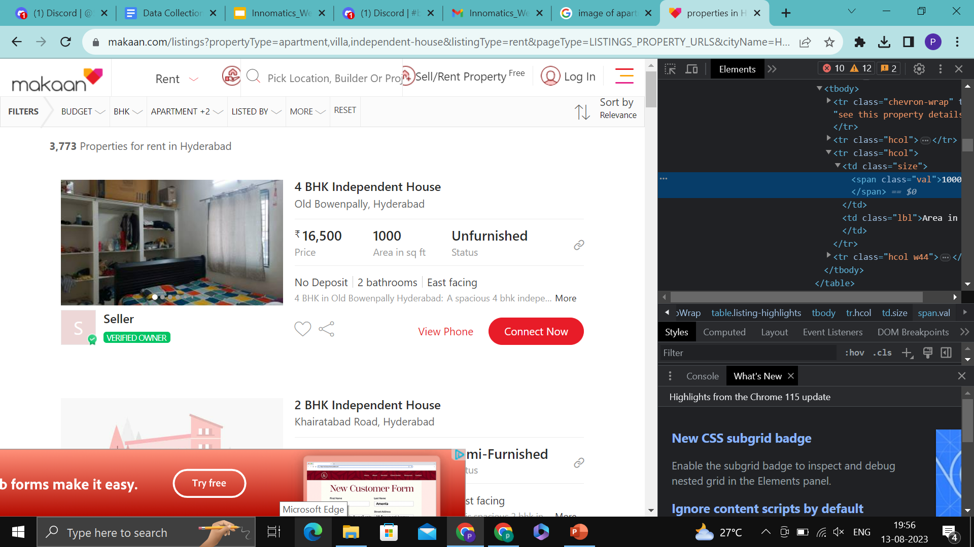
Web Scrapping Details-websites and process we followed

Slide 6
Web Scrapping Details-websites and process we followed
We used https://www.makaan.com/listings?propertyType=apartment&listingType=rent&pageType=CITY_URLS&cityName=Hyderabad&cityId=12&templateId=MAKAAN_CITY_LISTING_RENT website for the collection of data.
First we selected the website and from that website we have selected the categories (Villa,Apartment,Independent house).
Then we collected the data and perform exploratory data analysis.

Slide 7
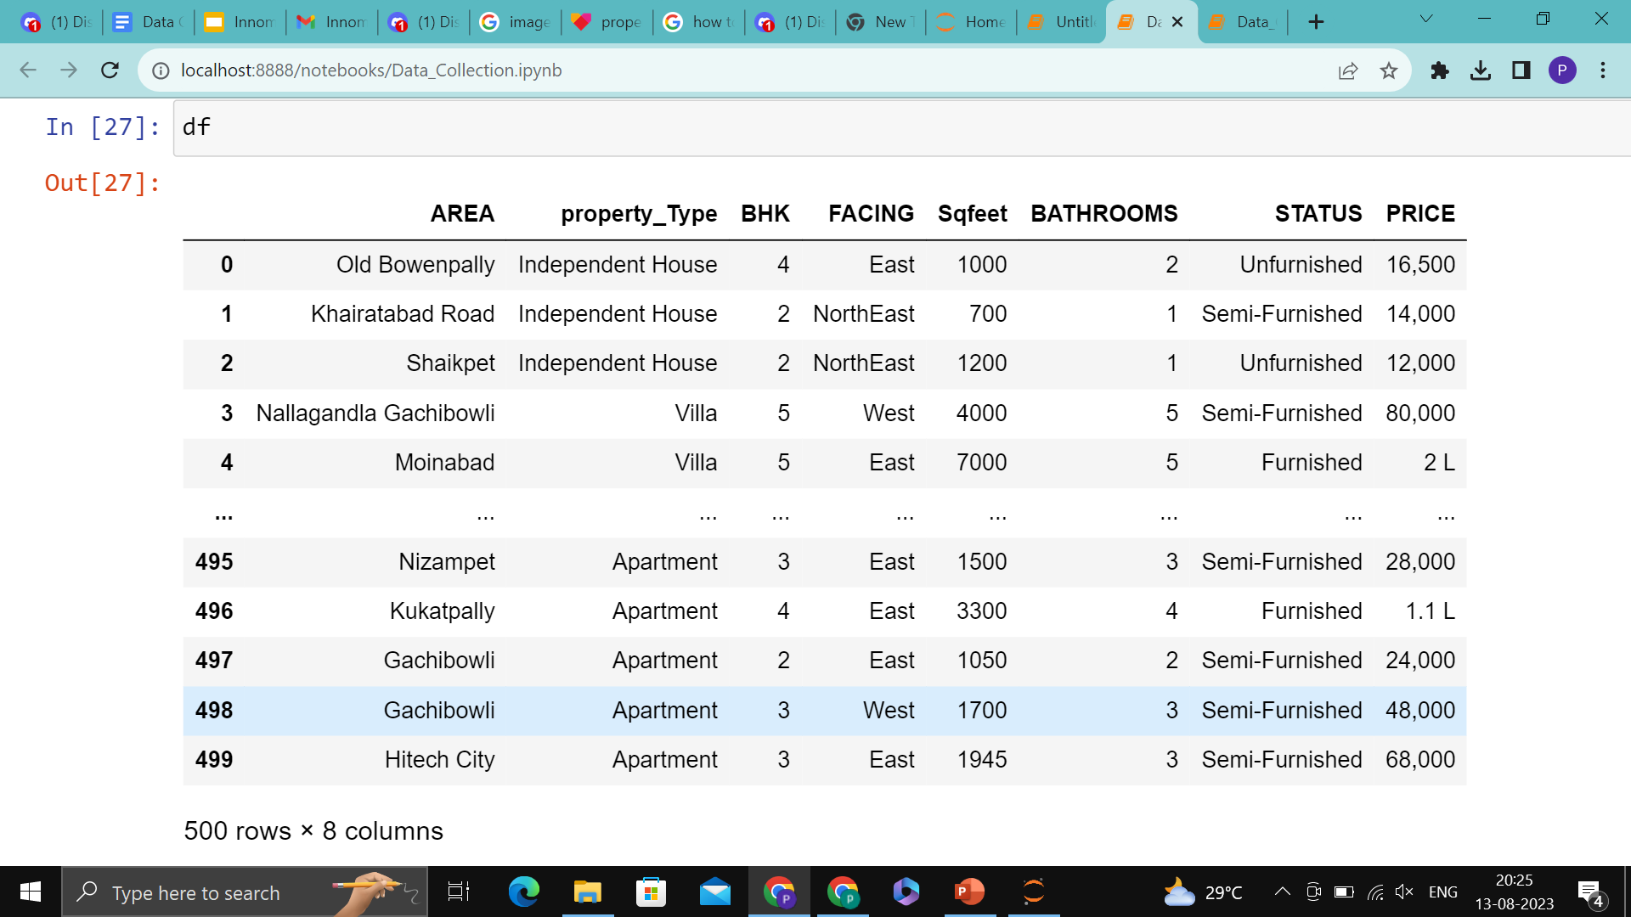
Raw Data

Slide 8
Data Cleaning and Data Manipulation Steps
Removing special characters[(,) from price]
Dropping of Nan’s(Facing, BHK, Property type)
Changing the Data Type of the columns(BHK,Price)

Slide 9
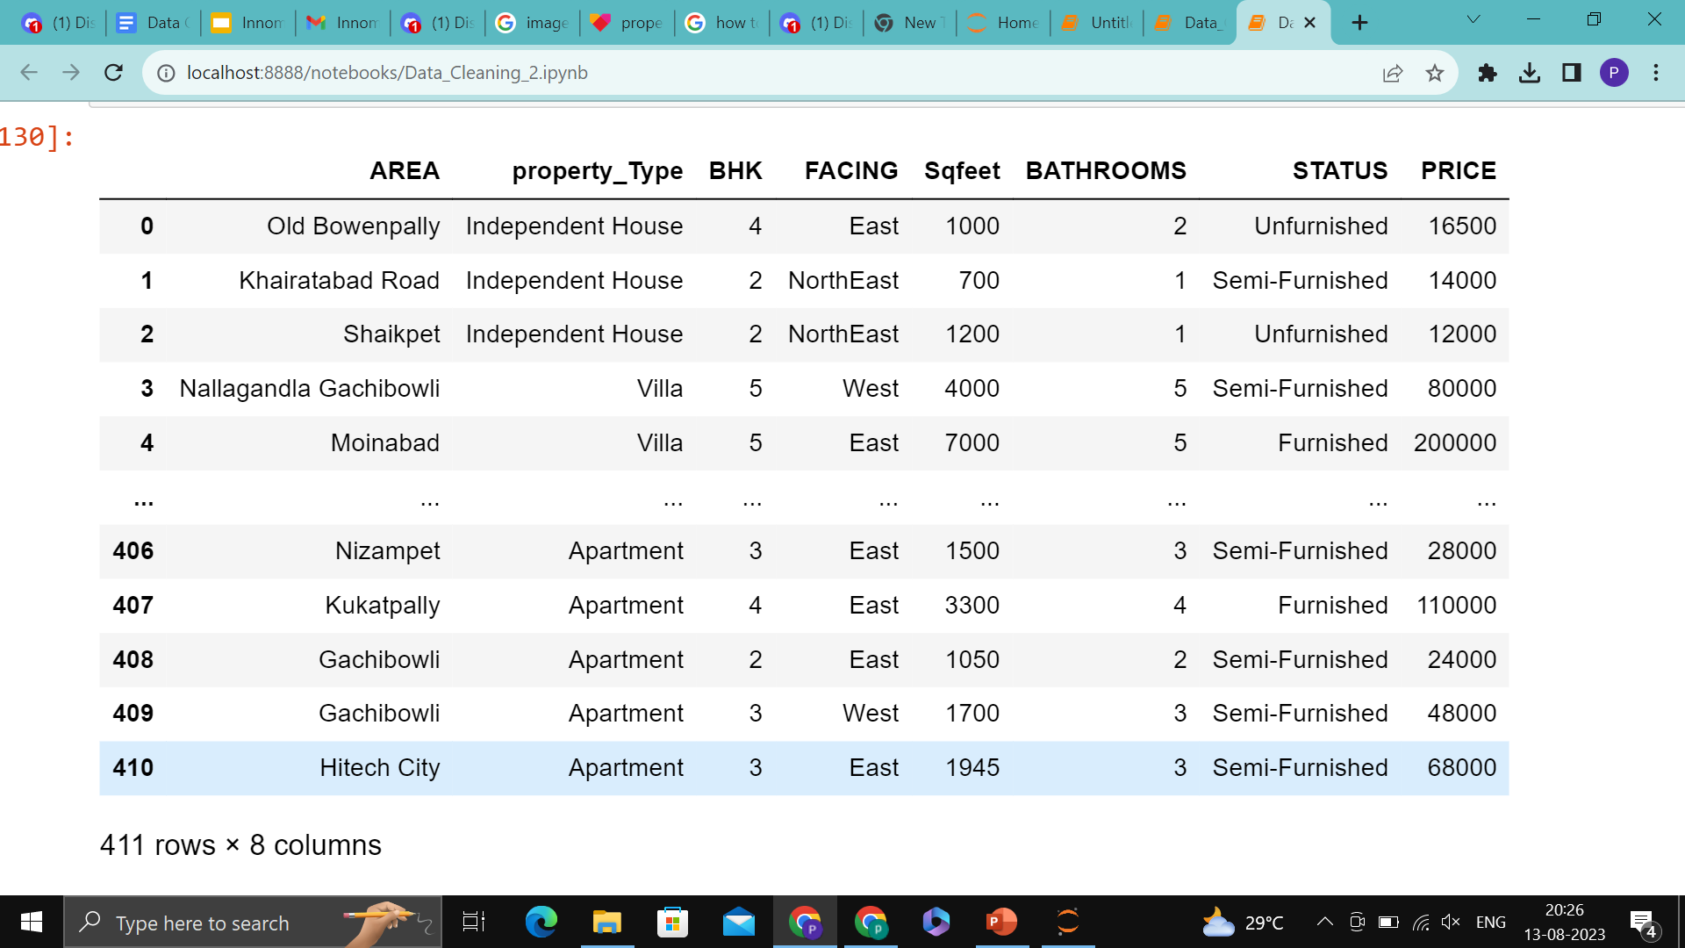
Cleaned Data

Slide 10
Data Visualization
Data visualization is the graphical representation of information and data. By using visual elements like charts, graphs and maps, data visualization tools provide an accessible way to see and understand trends, outliers and patterns in data.

Slide 11
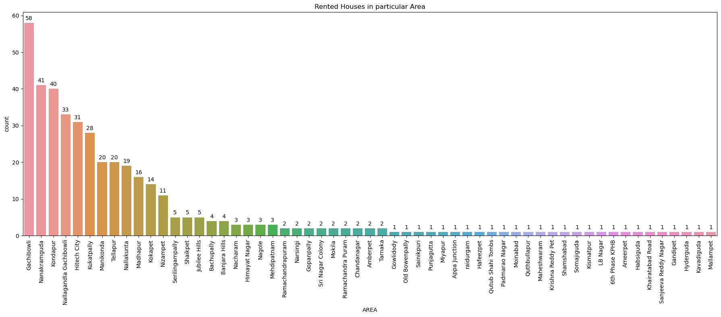
RENTED HOUSES IN EACH AREA
The above Graph Depicts that the 3 day tours has highest no of 5 star ratings ,and the 2 day tours has highest no of 4star Ratings.
For the 1 Day tours 3 star ratings are higher.
In Gachibowli there are more number of rented houses compared to other areas.

Slide 12
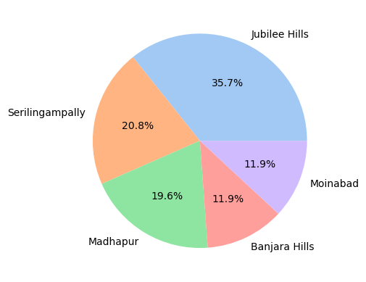
Area with highest Rented Prices
Pie chart on top 5 areas
This piechart shows the percentage of price on top 5 areas.
The price of the rented houses in Jubilee hills is high.

Slide 13
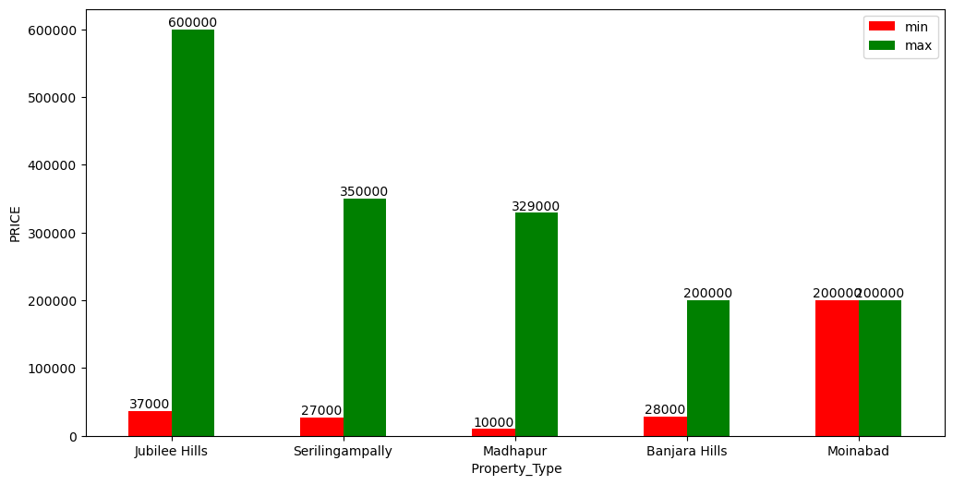
Max and Min prices of Areas
Bar plot on min and max prices on top 5 areas
The above barplot shows that the cost of rented houses in jubilee hills area is more.

Slide 14
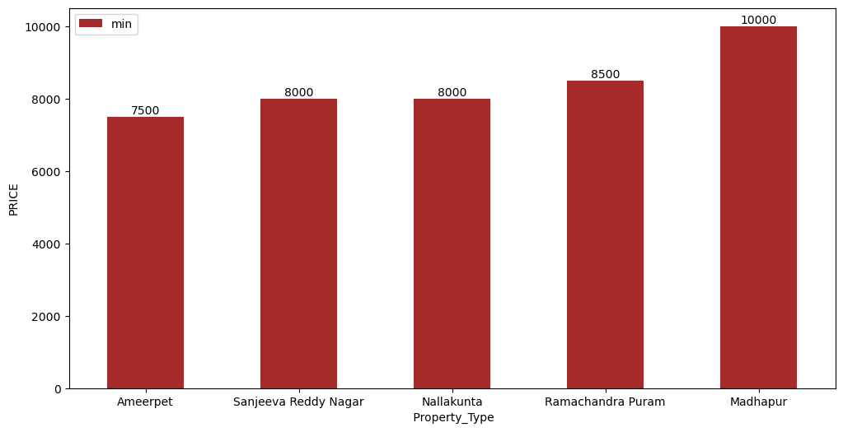
Areas with low price rented houses
In Ameerpet rented house prices are very low.

Slide 15
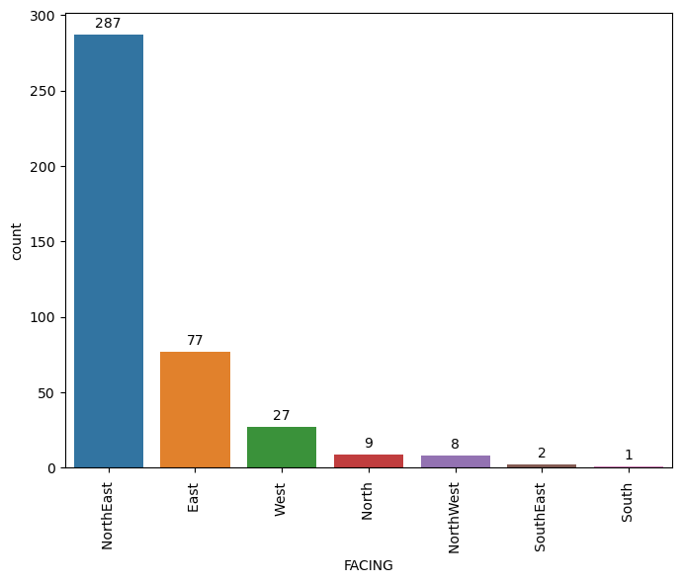
FACING
Count plot on facing
Count plot shows that the NorthEast facing flats are high in the rented houses.

Slide 16
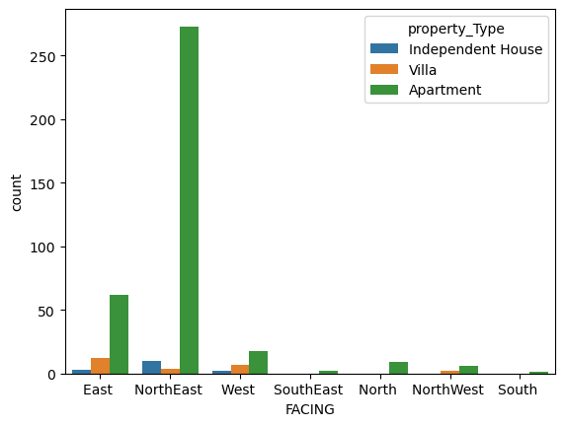
Property type and facing
Count plot on apartment
Count plot shows that NorthEast facing apartments are high.

Slide 17
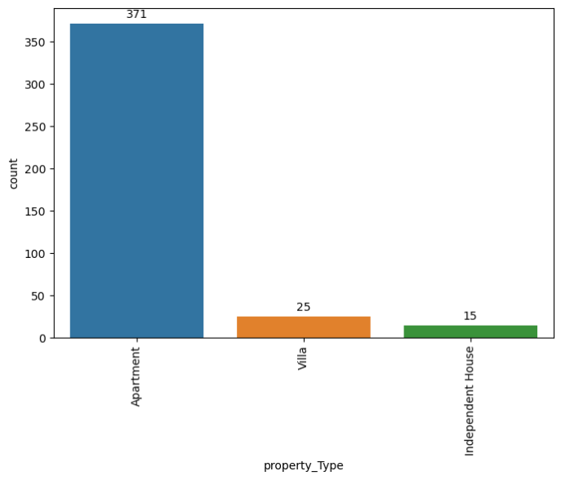
Property type
We found Apartment type of rented houses are more in Hyderabad .

Slide 18
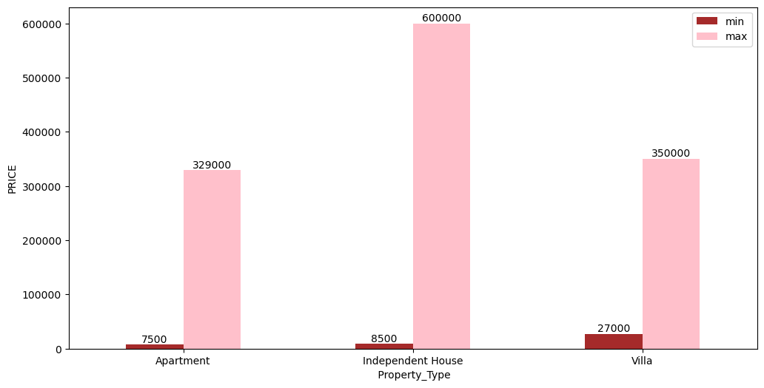
Min And Max Price Of Property Type
From the bar plot we can know that the price of the independent house is high.
The price of the apartment is low in rented houses.

Slide 19
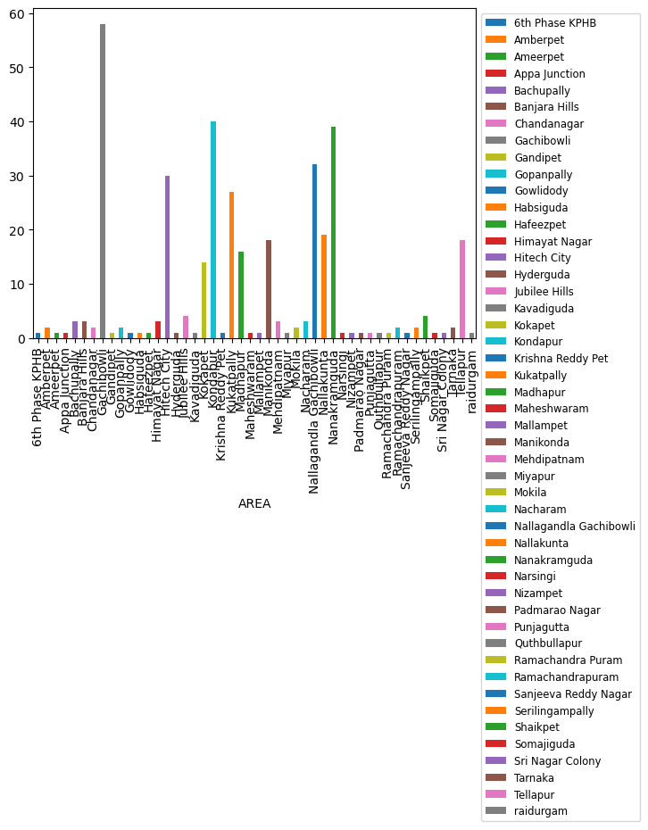
APARTMENTS IN EACH AREA
Apartment type of rented houses are mostly found in Gachibowli.

Slide 20
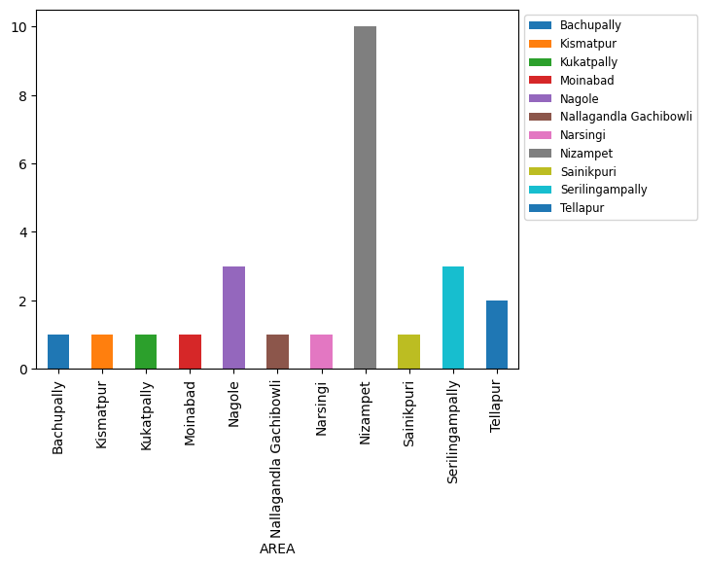
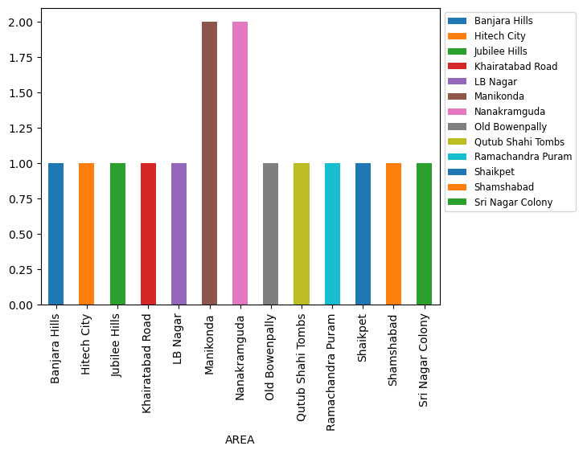
VILLAS AND INDEPENDENT HOUSES IN EACH AREA
The stacked bar plot shows that most of the villas are found in Nizampet.
Most of the independent houses are found in Manikonda and Nanakramguda.

Slide 21
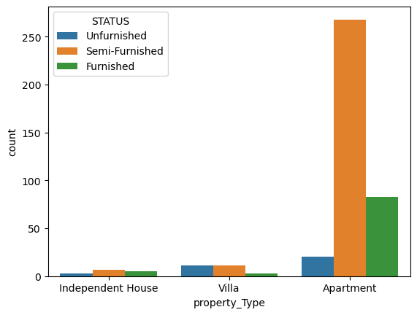
Status Of The Property Type
This count plot shows that there are more number of semifurnished apartments present in the rented houses.

Slide 22
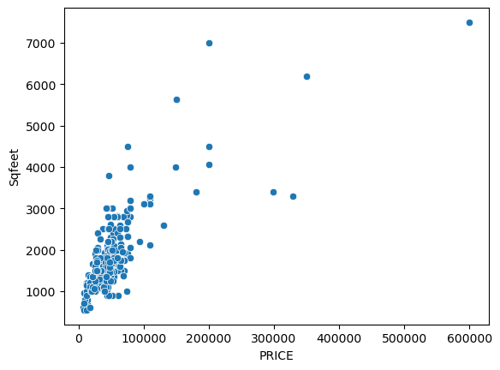
Price Vs Sqfeet
Scatter plot shows that most houses price is below 1L and the sqfeet is between 1000 to 3000.

Slide 23
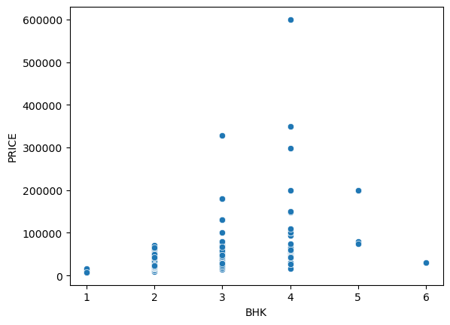
BHK Vs Price
Scatter plot on
Scatter plot shows that 3BHK and 4 BHK’s are more and the price is upto 1.5L.

Slide 24
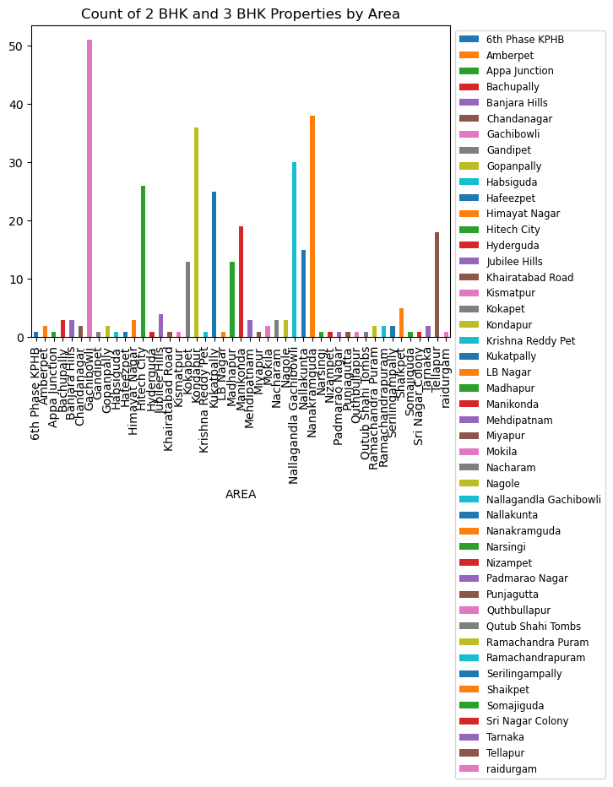
From this count plot we can know that majority of the 2BHK’s and 3 BHK’s are present in the Gachibowli

Slide 25
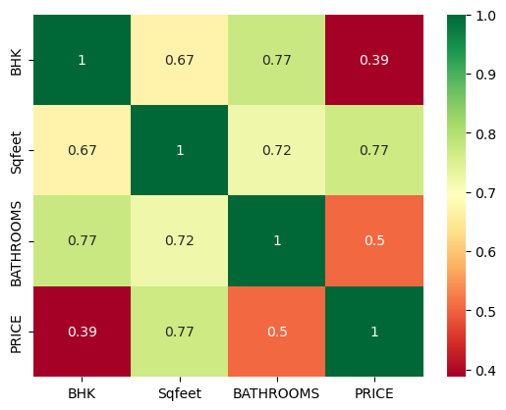
Correlation HEAT MAP
Heat map is defined as a graphical representation of data using colors to visualize the value of the matrix.
Heat map shows the correlation between Price,Bathrooms,Sqfeet and BHK.
We found less correlation between BHK and Price.

Slide 26
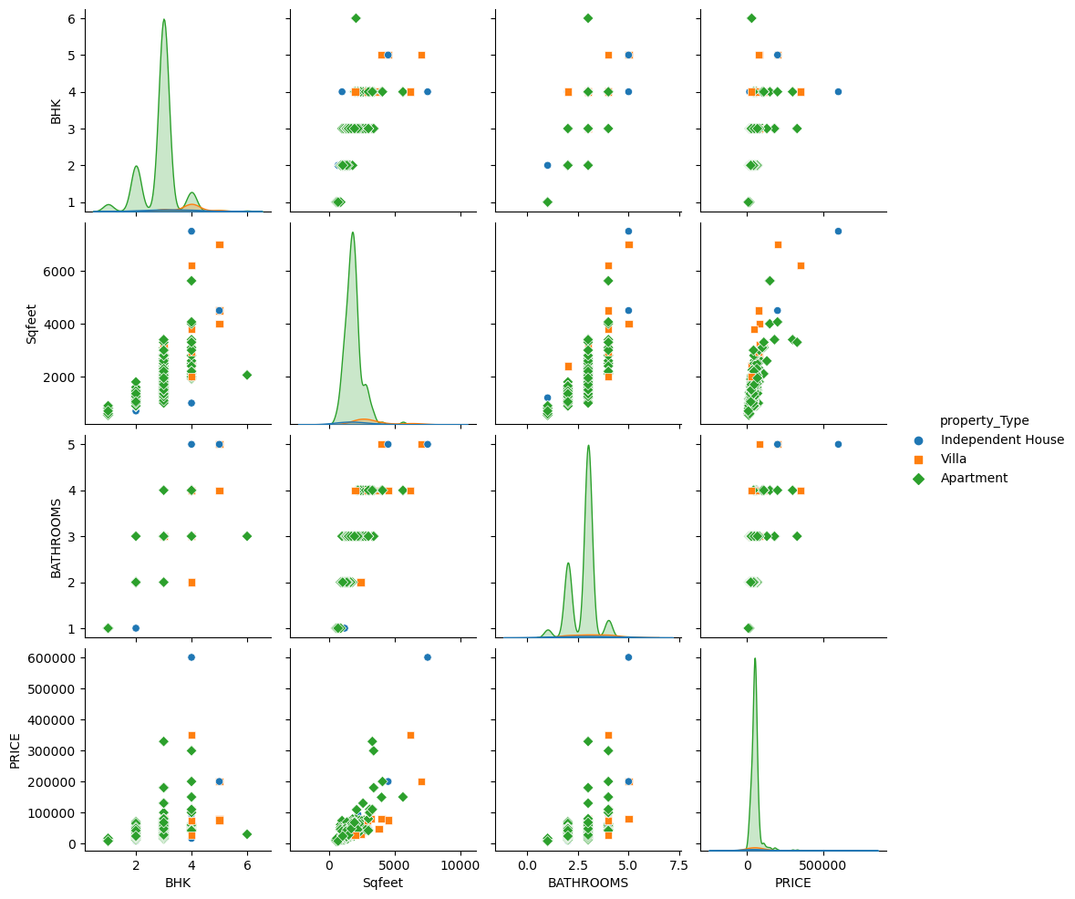
PAIR PLOT
Pair plot on BHK sqfeet bathrooms price

Slide 27
Conclusions
As per the complete Data Analysis, we conclude that:-
In Gachibowli we found more number of rented houses.
The cost of rented houses price is high in Jubilee Hills Area.
We found mostly Apartment types of rented houses.
North East facing rented houses are much higher than other-facing rented houses.
Most of the rented houses in Hyderabad are coming with a semi-furnished status.
BHK and price are less correlated to each other.
The average price of rented houses in Hyderabad is 55,000

Slide 28
Our Experience /Challenges Working on Web Scrapping – Data Analysis Project.
The initial problem we faced was we couldn’t find the correct Website where we’re unable to Scrape the complete data.
We felt little bit difficulty in scrapping the data using the Regex.
One of the major difficulty we faced is with cleaning of the Data and Data types.

Slide 29

THANK YOU

